Slide 1
Forming A Youth Leadership Council Program (YLC)
Bryan Ferreira, California PAL Staff

Slide 2
Californa PAL YDC/YLC History
The YDC was established for CalPAL in 2002.
The concept was introduced by CalPAL membership during the 2002 Spring Conference
12 youth were selected to attend the Florida State YDC conference and became the first members of the YDC Board of Directors.
Most PALs are using the name Youth Leadership Council (YLC) and the CALPAL State Board is YDC.

Slide 3
What a YLC program entails:
Youth Leadership Council is a program designed for older middle school to high school aged PAL youth that are possible leaders within your program.
Engage youth by doing community service
Provide positive peer role models for other PAL kids and a continuous forum to improve their lives
Form of reaching out to those youth who want to get involved but don’t know how

Slide 4
The Concept of YLC
Is to explore, discuss and recommend effective ways to engage in the activities of their PAL/SAL
Membership will provide youth with leadership opportunities, education, new relationships and lots of fun.
Youth work with peers for the betterment of their PAL/SAL and their community.
Promote positive peer pressure

Slide 5
Goals of the Youth Leadership Council
Involve youth in the decision making process as it pertains to policies, programs and activities of their PAL/SAL
Train youth in the democratic process of governing their own YLC
Encourage youth doing volunteer community service
improve communication between PAL/SAL staff and youth they serve.
Provide positive peer role models and a continuous forum to improve their lives.
Teach youth how to organize and conduct meetings according to the Roberts Rules of Order
Provide a way to reach out to youth who want to become a part of something but don’t know how
Install a sense of civic pride and responsibility, develop leadership skills, improve self-esteem and be a voice at their PAL/SAL
Be an alternative to juvenile crime.

Slide 6
Membership Requirements
7th grade through 12th grade, in school
2.0 minimum GPA
No negative contact with any law enforcement agency within the last six months
Be alcohol, drug, and tobacco free
Willing to volunteer 4-8 hours of community service per month
A letter of recommendation from non-family member
Your PAL can set its own requirements for membership

Slide 7
Why should your PAL form a YLC??
Free Labor
Use your youth for community outreach events (block parties, face painting, fingerprinting)
Community Service
Engage youth in positive activities
PAL exposure
Through community service

Slide 8
How to start a Youth Leadership Council
PAL Executive Director presents program to Board of Directors
If approved, Exec. Director appoints a YLC advisor (either PAL staff or other)
Invite youth to attend meeting to introduce concept (current PAL youth)
Set up a planning meeting date

Slide 9
The Planning Meeting
YLC meeting length and frequency
YLC structure (officers, roles, titles)
Draft of Mission or Purpose statement
Draft By-laws for YLC
Suggest community service projects
Select date for YLC Board of Directors elections
CalPAL Samples and Drafts

Slide 10
Next Steps to take…
Elect YLC Board Officers
Finalize Mission Statement
Finalize By-laws
Plan community service projects
Select fundraisers for miscellaneous expenses
Appoint reporter for YLC newsletter

Slide 11
YLC Advisor’s Role
The Youth Leadership Council belongs to its membership.
The advisor is there for advice, guidance and wisdom.
The membership makes decisions and decides on the direction of YLC.

Slide 12
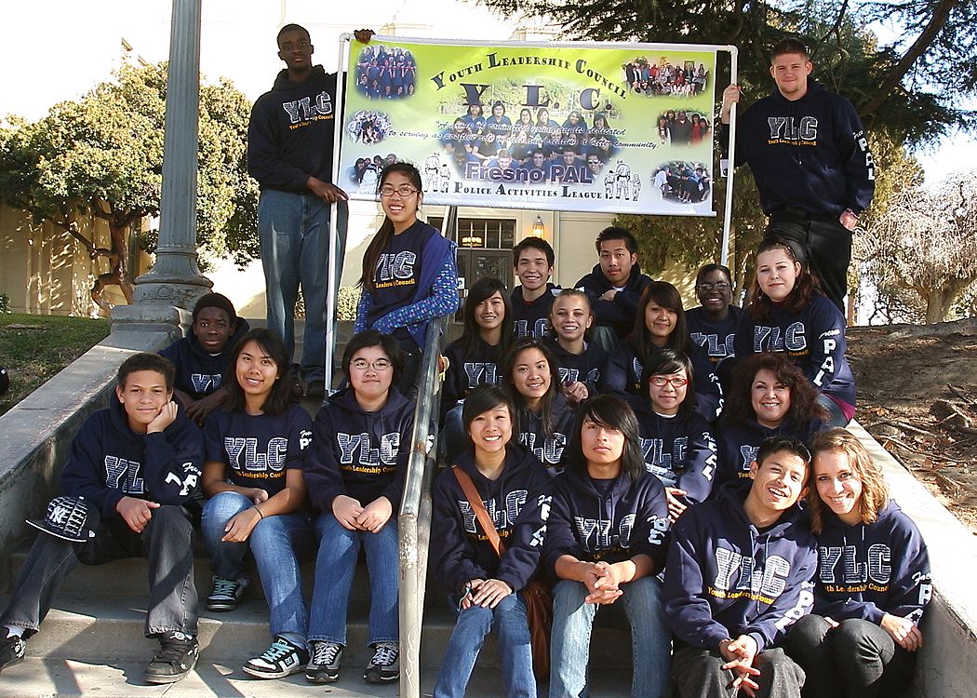
Example of a YLC Program

Slide 13
Why YLC works at PAL
Members share same values
College goals
Community Service & “Making a Difference”
Leadership
Enjoy time together while working and having fun
Take projects upon themselves and get them completed
Always willing to do the tasks at hand

Slide 14
The PAL Cycle
PAL Kid
PAL Volunteer
YLC Member

